Slide 1
TABLEAU

Slide 2
Quick Look
Tableau is a rapid BI software.
Founded in 2003, headquartered at Seattle, Washington by Christian Chabot, Chris Stolte, Pan Hanrahan.
Powerful Visualizations and Vivid Graphical representation.
Ease to use: It's easy enough that any Excel user can learn it, but powerful enough to satisfy even the most complex analytical problems.
Indefinitely Faster.

Slide 3
TABLEAU vs SAP BO
Tableau | Enterprise Reporting Tool
Real Time Visualizations on the fly | Large enterprise wide deployments
Maps are far superior in tableau, especially with Map Box | Good for Printed, Formatted Tabular and scheduled Reports
Hierarchies are far better | Hierarchies are less user friendly
New data source drivers are supported readily | Does not support new data source drivers readily

Slide 4
TABLEAU PRODUCTS
Tableau Desktop
Tableau Server
Tableau Online
Tableau Reader
Tableau Public
Tableau Mobile

Slide 5
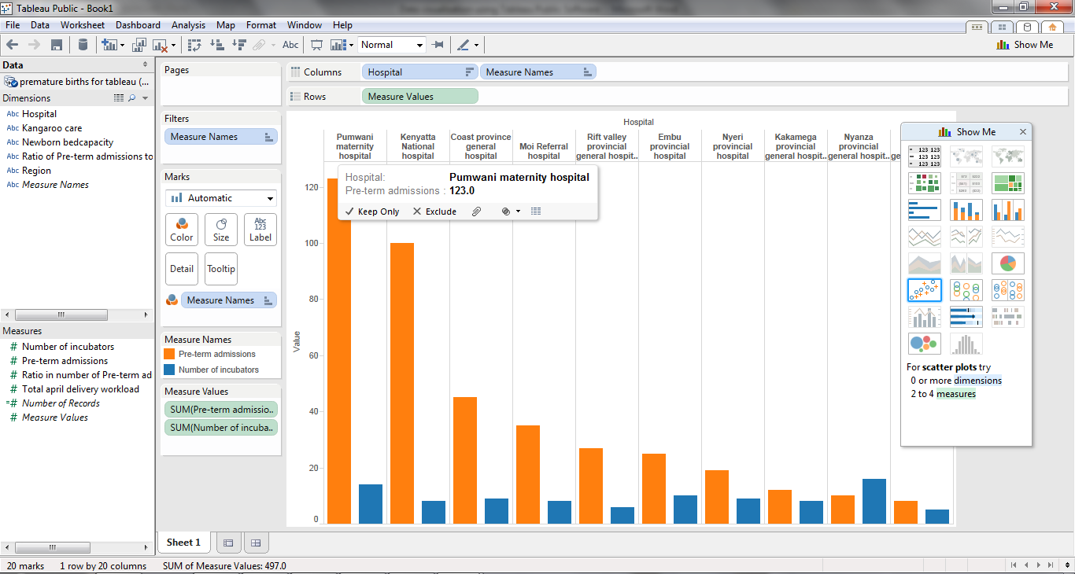
Tableau PRODUCTS
Tableau Desktop
ad hoc analytics, dashboards, reports, graphs
explore, visualize, and analyze your data
create dashboards to consolidate multiple views
deliver interactive data experiences

Slide 6
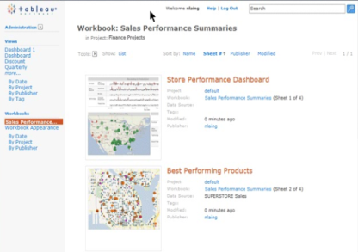
Tableau PRODUCTS
Tableau Server
business intelligence solution scales to organizations of all sizes
share visual analytics with anyone with a web browser
publish interactive analytics or dashboards
secure information and manage metadata
collaborate with others

Slide 7
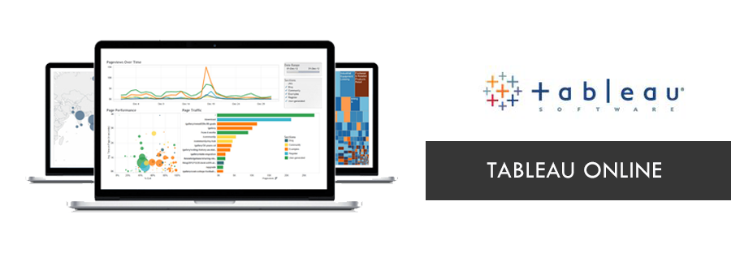
Tableau PRODUCTS
Tableau Online
Tableau Online is a hosted, SaaS version of Tableau Server
publish interactive analytics or dashboards
secure information and manage metadata
collaborate with others
Can share workbooks and dashboard via web.

Slide 8
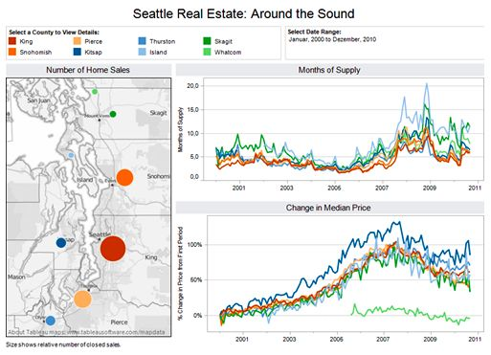
Tableau PRODUCTS
Tableau Reader
share visualizations & dashboards on the desktop
filter, sort, and page through the views
TWBX format only will be used
Read only access
free download

Slide 9
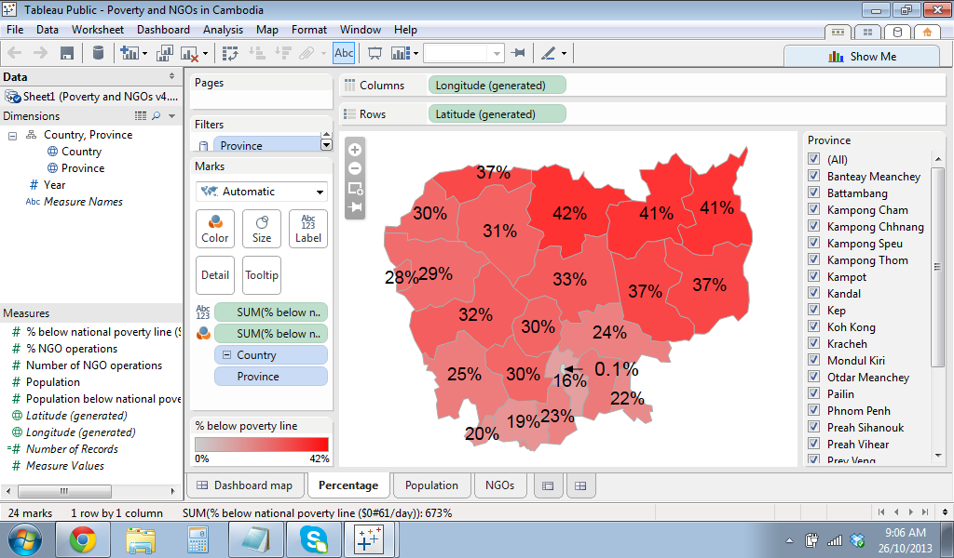
Tableau PRODUCTS
Tableau Public
create and publish interactive visualizations and dashboards
embed in websites and blogs
free download and free hosting service

Slide 10
Tableau Server Vs Online
Tableau Server | Tableau Online
Specific hardware set up and maintenance is required | Hosted in cloud by tableau
Self Hosted | Tableau Hosted
No extra cost. Requires only optimal hardware and IT resources. | Pay extra for new site access
Can connect live to On-Premise and hosted data | Can only connect Live to certain cloud-Hosted data
Local Authentication or Active Directory | Use Email for Authentication
Server is only limited by your hardware choices. | size of extracted data is limited to 100 gigabytes per site

Slide 11
Data Extraction
We have two types of connection in tableau.
Extract Connection
- Is a Connection with a static database, which is refreshed every day/hour/period.
Live Connection:
- live connection will query the underlying data in the data source/database
- refreshing the visualization will give you the latest results

Slide 12
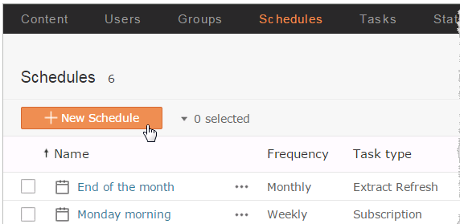
Scheduling via Server
We have two types of connection in tableau.
Extract Connection
- Is a Connection with a static database, which is refreshed every day/hour/period.

Slide 13
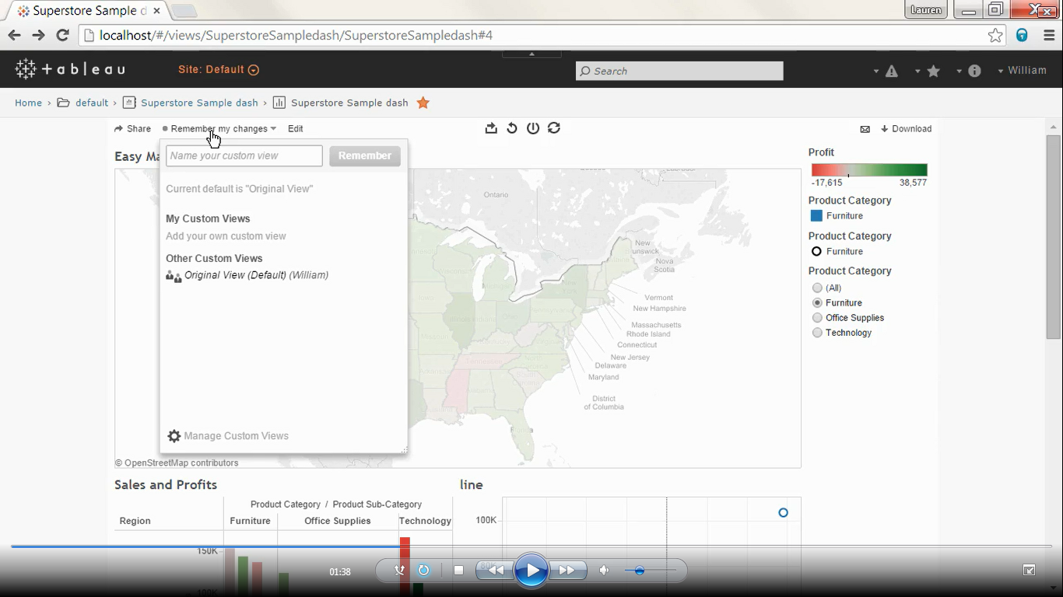
Interacting with server
View changes can be saved.
Share the views
Download the data
Export data, static image, cross tab or pdf
Write comments

Slide 14
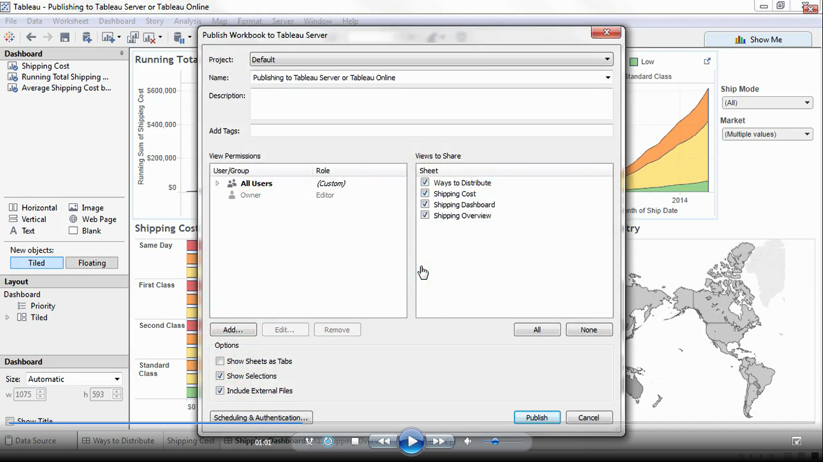
Publishing Workbook
Give project name and description
Permissions can be set.
Refresh report when it is scheduled
Download the data

Slide 15
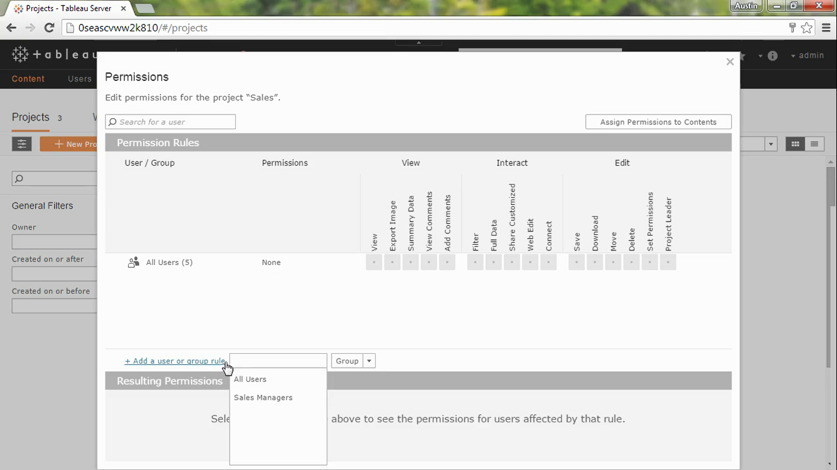
Authorizations and Permissions
Used to set permissions to particular group.
This can be done only from admin perspective.
Create permissions to group or individual user.
Permission are not set then considers as denied

Slide 16
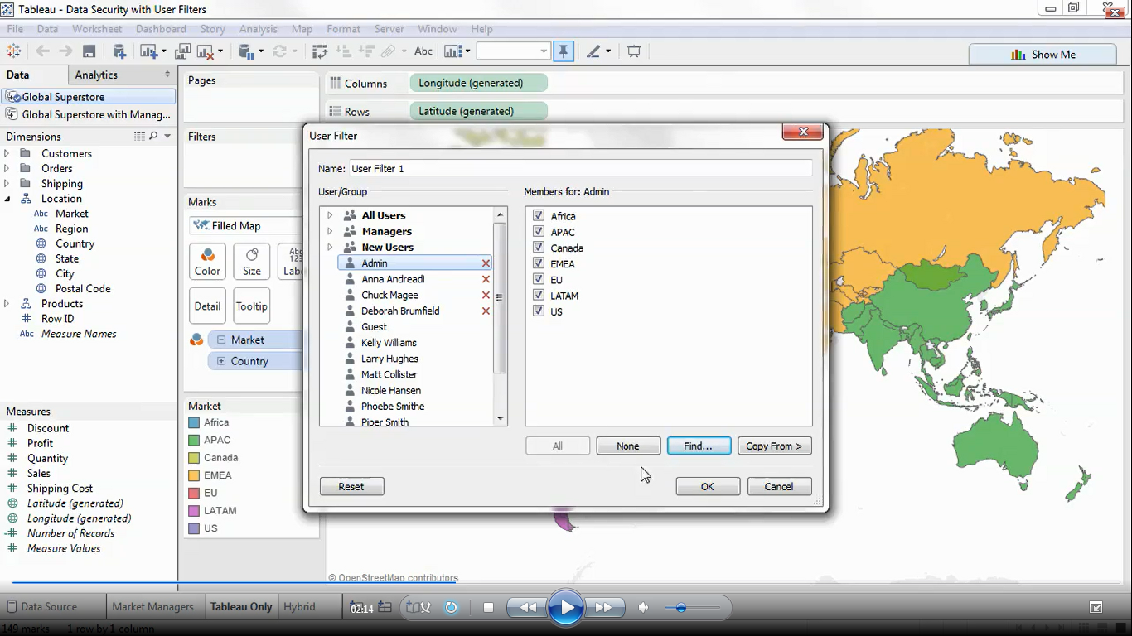
Data Security
We can even set security to the data.
Apply to workbooks and Data sources.
Workbook → create a user filter from the server option.
Data source → Right click the data source – Edit Data source filters – Add – Created filter

Slide 17
Best Practices
Connect to all of your data.
Blend your data together
Choose metrics that matter
Utilize better visualizations
Use your data in the field
Share for Collaboration

